Slide 1
Twitter for Natural Language Processing
Katie J. Sullivan, Ph.D.
Prescription Drug Epidemiologist
CO Dept. of Public Health and Environment (CDPHE)
September 28, 2021
katherine.sullivan@cuanschutz.edu
katherine.sullivan@state.co.us

Slide 2
Agenda:
Overview of Twitter data
Overview of natural language processing (NLP)
Example project using Twitter data for NLP
Questions

Slide 3
Accessing the Twitter API
“Twitter is what’s happening and what people are talking about right now.”
330 million active users/month¹
Current public discourse and sentiments
Getting started:
Application Programming Interface (API) for academic researchers
Create a Twitter developer account and apply for academic research product track (https://developer.twitter.com/en/solutions/academic-research)
There are various tools, including Twitter’s GET, TwitteR (for R), python-twitter package, Tweepy, etc. that will allow you to access the data; each of these has their own language
This Photo by Unknown Author is licensed under CC BY
Notes:
It is primarily useful for evaluating current public discourse and sentiments, but has been used as a data source for many different kinds of research studies: Twitter defines itself as what’s happening and what people are talking about right now, so if you’re interested in something like current and ongoing sentiments surrounding COVID19 vaccines, for example, Twitter might be a good source for that.
Before you can start using Twitter, you have to get yourself set up, so the first thing to note is that
Twitter has an Application Programming Interface (API) specifically catered toward academic researchers, which is pretty neat
So if you have a project you know you want to do, you would go to their developer site and create a Twitter developer account by applying for the academic research product track, and this will give you access to more data than a standard developer account
For example, you should be able to access historical tweets, as opposed to just the past seven days that a standard developer can access.
Through your developer account, you will be given a specific access token and a specific access token secret that will be used to authenticate the “app”/project you’ve created in order to use the Twitter API
Once you’ve done this, you can use whatever program you’re comfortable with, like python or R, to access and query the twitter data you want to use for your project. You’ll need that access token and access token secret for this. At this point, I would recommend looking up a coding-language specific tutorial online that gives you the code you’ll need to access the data you want to query. There are many methods for querying Twitter data, and there are tutorials and Github pages dedicated to this that will guide you through much better than I can do in this short presentation. Toward Data Science is a great site that publishes many of these tutorials, so I’d probably start there.

Slide 4
Twitter Data
Who: ²
340 million total users with 74.8 million (22%) in the U.S.
1 out of 5 U.S. adults use Twitter
77% of Americans who earn $75,000/yr. use Twitter
80% of tweets come from the top 10% most active users³
Notes:
It’s important to know who uses Twitter, and to reflect on how this may bias any conclusions made in a study that uses Twitter data.
Twitter users tend to be younger, tend to be more affluent, and tend to be what we might call politically left leaning.
In addition, research shows that 80% of tweets actually come from the top 10% of users, so depending upon how your queries are structured, you may not be getting a variety of tweets from a lot of different users, but are instead getting the tweets of a small subset of users.
So there are limitations to take into consideration if you’re considering using Twitter as a data source

Slide 5
Twitter Data
Data fields:
Tweet
User
Media
Poll
Place
This Photo by Unknown Author is licensed under CC BY-SA
Notes:
There are really five major fields, or objects that you can access. I would recommend going to the Twitter developer data dictionary available online for a better rundown on all of them.
First you have the tweet, of course. This is the text of the tweet itself. The tweet object also has the ID, which is not the User ID, but rather the unique identifier of that tweet. Every tweet has one of these, and it is how you can programmatically request the API to find that specific tweet. Among other things, the tweet also has the author_id, which is the unique identifier of the user who posted the tweet. This number can be used to hydrate the user object which I’ll talk about next.
The User field or object contains the metadata for the user, so things like the author_id number, name, username, when their account was created, text of the users bio if they provide that on their account, and a freeform location value if they have that.
There is also a media data object which is basically an image, GIF, or video attached to a Tweet if the user has posted one.
The poll object gives you the date and time that a poll was created on Twitter, as well as the options available in the poll.
And last is the place field, which if the user allows on their tweet, is a geo tag of the tweet, including the name of a place, the type of place such as city; it gives you the country, and the location in geoJSON format, which will tell you longitude and latitude. Just bear in mind that only about 1-2% of tweets are actually geo tagged, but there may be other ways to get at location data, like in the text of the tweet, for example.

Slide 6
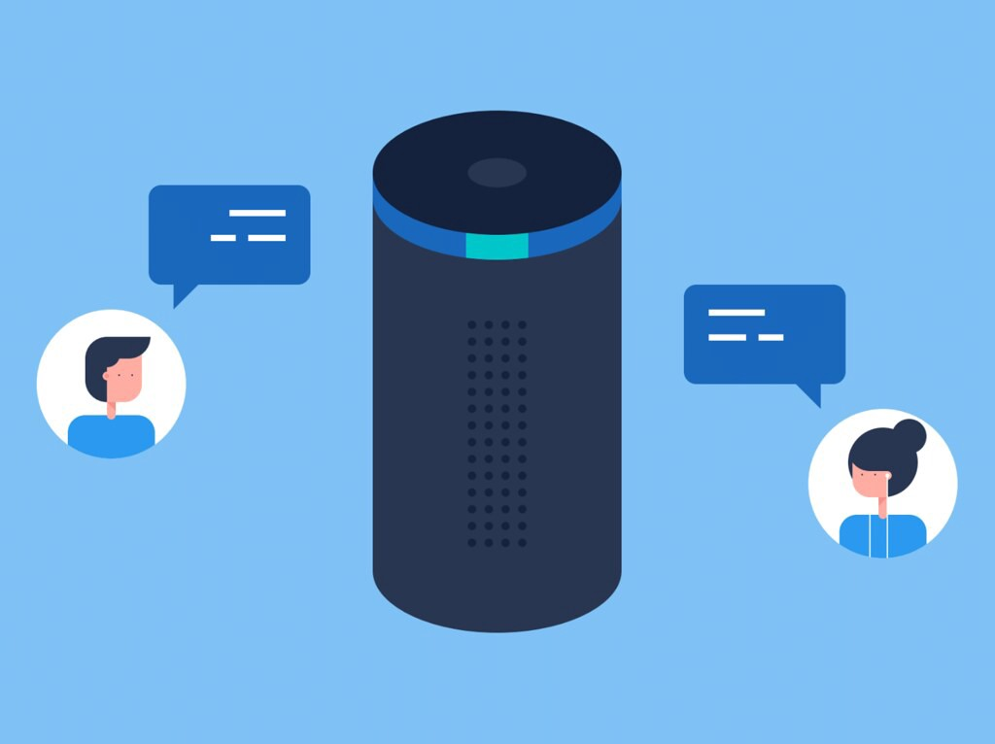
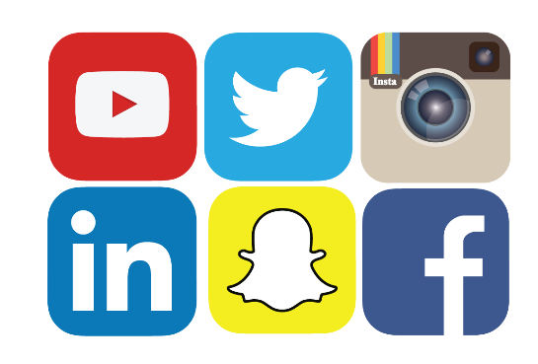
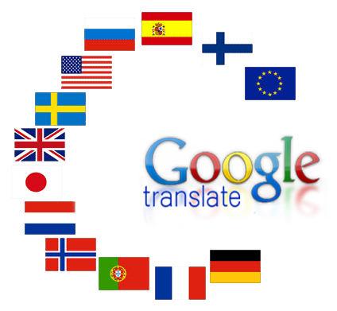
Common Examples of NLP in the World
Spam detection
Alexa/Siri/Google Assistant
Spell check
Internet searching autofill and prediction
Social media monitoring
Chat bots
Language translation
Predictive language modeling
Notes:
These are some common ways that natural language processing is used in everyday life.

Slide 7
NLP Definition
Natural language processing is computing over human language.

Slide 8
Characterization of Anonymous Physician Perspectives on COVID-19 Using Social Media Data
Understanding the physician perspective may help identify opportunities for improvement
Insight into impact of COVID-19 with regard to:
Frontline healthcare workers
Patients
Public¹⁻⁴
Social media has become a valuable resource for evaluating current public discourse and sentiments and is increasingly being used in the healthcare arena⁵⁻⁷
Objective: Analyze topics and sentiments of COVID-19 physician tweets and compare them to a broader baseline of COVID-19 related tweets.
Physician perspectives can potentially:
Improve health outcomes
Inform health policies
Affect health systems’ safety culture
Sullivan KJ, Burden M, Keniston A, Banda JM, Hunter LE. Characterization of Anonymous Physician Perspectives on COVID-19 Using Social Media Data. In: Biocomputing 2021. WORLD SCIENTIFIC; 2020:95-106. doi:10.1142/9789811232701_0010
https://www.worldscientific.com/doi/abs/10.1142/9789811232701_0010

Slide 9
Methods: Data
English tweets posted between March 16-July 17, 2020
Words lemmatized
Remove punctuation, special characters, URLs, stop words
Physician tweets dataset for analysis (n=875 tweets)
Data scraped from specific Twitter user account: @COVID19Docs
(https://twitter.com/Covid19Docs)
Comparison data: larger Twitter COVID-19 discourse data⁸
513 million tweets gathered from Twitter streaming API
Maintained by researchers at Georgia State University
Removed tweets not in English, retweets, and bot tweets

Slide 10
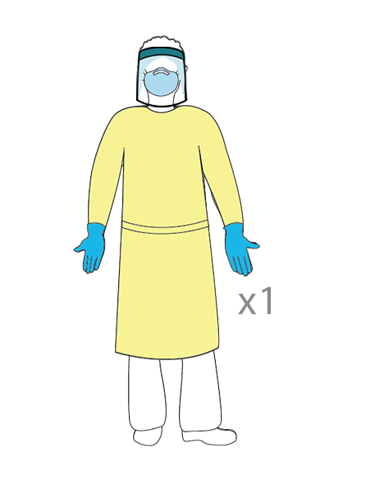
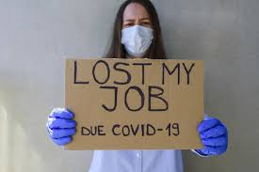
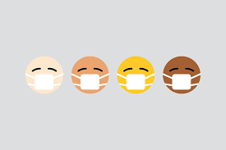
Methods: Analysis
Compared frequency of most common bigrams and trigrams and four pre-selected topics of interest between datasets:
1. Personal protective equipment
3. Telemedicine
2. Unemployment
4. Racial injustice
Notes:
With the help of an experienced hospitalist physician, we also identified four specific topics that were recognized to be important within physician and public discourse.
These phrases were personal protective equipment, unemployment, telemedicine, and racial injustice
We measured the frequency of these topics and the sentiments of tweets containing phrases related to these topics.

Slide 11
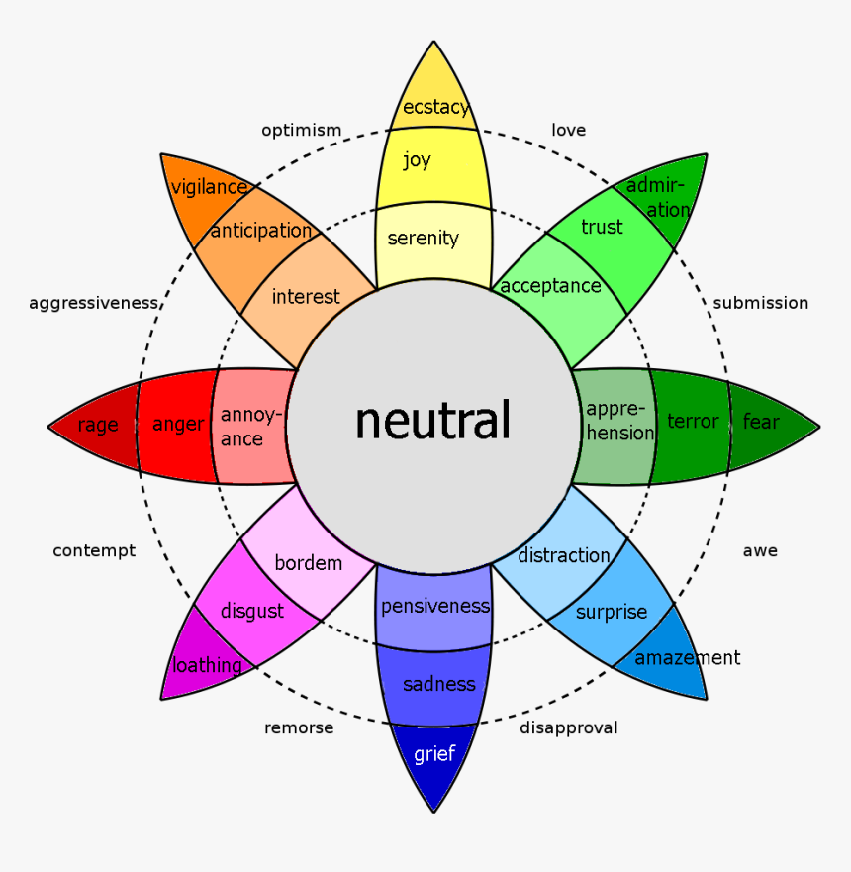
Methods: Analysis
11
Evaluated physician data sentiments with two popular sentiment analysis methods to gain insight into accuracy of such approaches:
NRC (National Research Council Word-Emotion Association Lexicon)⁹
VADER (Valence Aware Dictionary and sEntiment Reasoner)¹⁰
NRC based on Plutchik’s Model of Emotions
Compared results from VADER analysis to larger COVID-19 discourse data
Precision, recall, and F1 scores calculated: VADER sentiment results compared to manually classified sentiments for physician tweets
Notes:
In addition to just counting frequencies of topics in the tweets, we wanted to evaluate sentiments expressed in the physician tweets, and also garner some insight into whether certain sentiment analysis tools could accurately assess sentiments of these unique tweets.
We chose to use two pre-built sentiment analysis tools. One was called NRC and the other was called VADER. Both are unique and have their own strengths and weaknesses. VADER is catered more toward social media data, so we used results from that method to compare to the larger COVID-19 discourse data and to calculate accuracy measures against manually classified tweets.

Slide 12
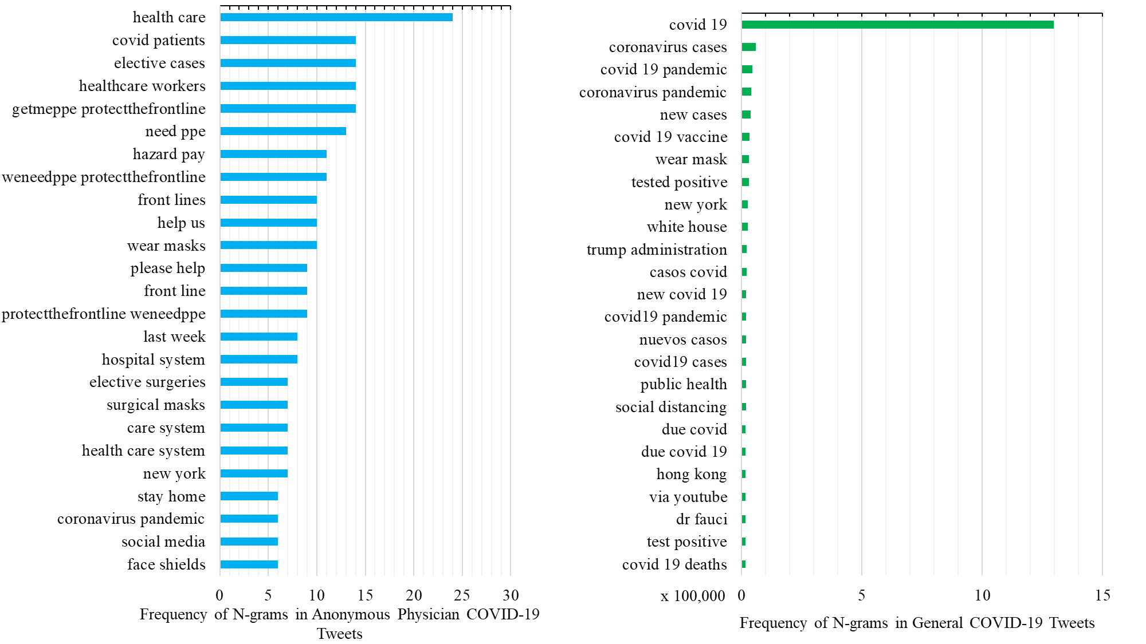
Results: N-Gram Frequency

Slide 13
Results: Frequency of Specific Topics

Slide 14
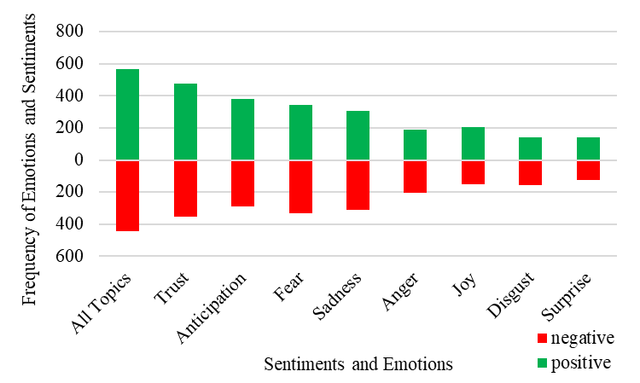
Results: NRC Emotions and Sentiments
NRC Word-Emotion Association Lexicon Sentiment Analysis of Anonymous Physician COVID-19 Tweets
Notes:
For the NRC sentiment analysis method, we can see that overall, it found more positive words than negative, and trust was the most frequent emotion identified in the physician tweets, with anticipation and fear coming in second and third.
Upon manually reading the physician tweets, trust was not necessarily the emotion that best describes these tweets, so there seems to be room for improvement here for this sentiment analysis tool with regard to this unique type of social media data.

Slide 15
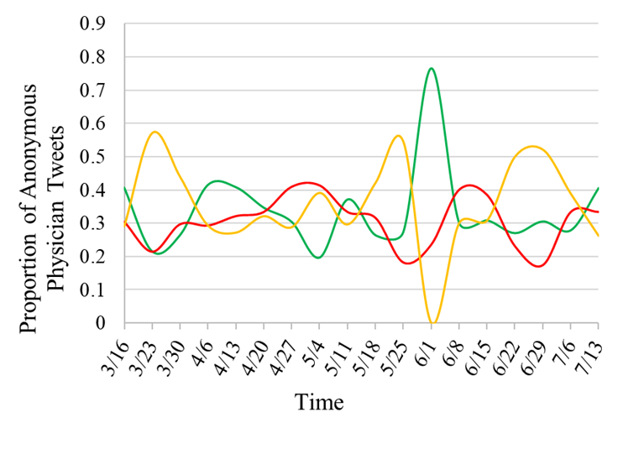
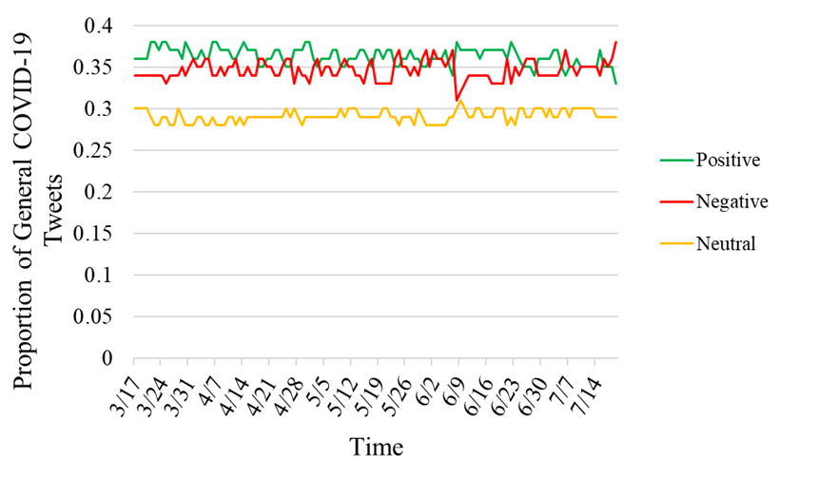
Results: VADER Sentiments Over Time
Proportion of Positive, Negative, and Neutral Tweets Over Time for Anonymous Physician COVID-19 Tweets (left) and General Covid-19 Tweets (right) using VADER Sentiment Analysis
Notes:
Now, moving onto the VADER sentiment analyses, these figures show negative, positive, and neutral sentiments over time for the physician tweets on the left, and for the larger COVID-19 dataset on the right.
In the larger COVID-19 dataset, there were slightly more positive tweets over time compared to negative tweets, while there is less distinction among the physician tweets.
Of course, there are far fewer physician tweets available, so it is possible that with more tweets over a longer period of time, the sentiments of the anonymous physician tweets would result in a comparable pattern over time to that of the larger COVID-19 dataset.
A majority of tweets for both datasets were assessed as being positive with no statistically significant difference in overall sentiment.

Slide 16
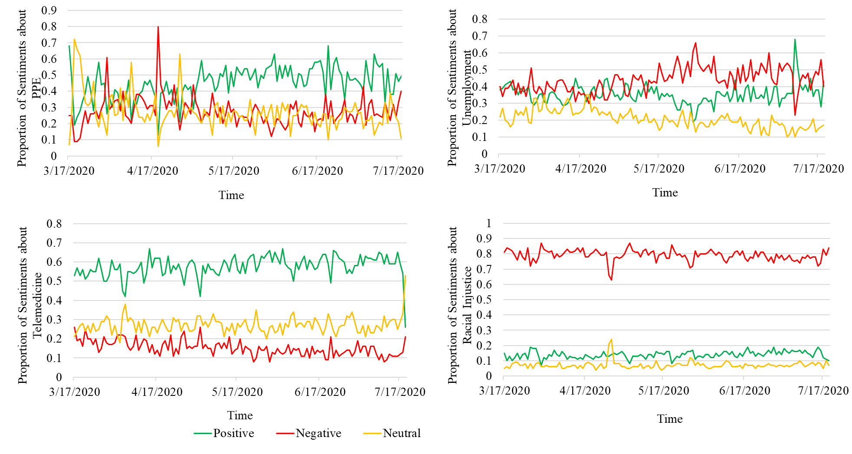
Results: VADER Sentiments for Specific Topics
Sentiments for tweets containing phrases about PPE, Unemployment, Telemedicine, and Racial Injustice for larger COVID-19 discourse dataset
For physician tweets, VADER ranked tweets containing topics of interest as:
PPE mostly positive (n=118)
38% pos, 36% neg, 26% neu
Unemployment mostly negative (n=14)
29% pos, 64% neg, 7% neu
Telemedicine mostly positive (n=12)
42% pos, 25% neg, 33% neu
Racial injustice all negative (n=2)
100% neg
Notes:
Here is where we assessed the sentiments of tweets containing the four topical phrases of interest.
The small size of the physician tweet dataset prevented us from assessing topic-specific sentiments over time, but the overall proportions are listed on the right of the slide.
The proportion of tweets for both datasets trended positive with regard to PPE and telemedicine, while unemployment and racism, as might be expected, trended more negatively.
It’s interesting to note what is happening in terms of current events during these timeframes; for example, in the top right graph for unemployment, there is a spike in negative sentiments when unemployment rates reached their highest to that point since the beginning of the pandemic, starting in April through May, and then declined in June.

Slide 17
Discussion
Discourse is slightly different between physician tweets and more general tweets
Uniqueness of some anonymity is important as it leads to posting more honest opinions and can lead to valuable insights for impactful change¹²
Sentiment analysis is difficult because human language is complex
Manual analysis of anonymous physician tweets vs VADER: F1 = 0.52 (precision = 0.63, recall = 0.56)
Table 4. Examples of Misinterpreted Paraphrased Tweets by Sentiment Analysis Compared to Manual Assessment of Tweets
Tweet | Sentiment Analysis | Manual Assessment
How is it fair for admin to silence doctors asking for help? | Positive | Negative
Physicians are afraid of losing jobs. | Positive | Negative
When faced with PPE shortages, the program director sourced 3D printers to make face shields! | Negative | Positive
Please help! No PPE!! Please help! | Positive | Negative
We are doctors and have NO PPE. Please donate if able-stop hoarding please! We need it to care for patients. | Positive | Negative
Notes:
So through our work here, we found that the discourse of anonymous physician tweets differs from the larger, more general Twitter discourse when it comes to COVID-19 topics.
Also, the ability of the physicians to maintain some level of anonymity on Twitter holds some importance; previous studies have found that anonymous social media data is different from more general social media discourse, particularly during a social crisis.
It tends to result in more honest opinions due to less risk of repercussions.
It would be beneficial for future work to improve sentiment analysis tools so they are capable of assessing anonymous physician social media data, since this type of data and these types of “masked” Twitter handles are not likely to disappear in the future.
Along those lines, since human language is complex, sentiment analysis can be difficult to get right.
We did a manual analysis of the physician tweets, and scored them positive, negative, or neutral, as the VADER sentiment analysis tool would do
Upon comparison with VADER, the F1 score was 0.52 with precision at .63 and recall at .56, and you can see from the examples in this table that there is perhaps room for improvement.

Slide 18
Discussion
Limitations:
Small sample of physician tweets
Physician tweets not completely anonymous
Sentiment analysis methods not meant for assessment of health-related, physician tweets that may have more clinical language
Future directions:
Create a lexicon specific to health-related social media data
Mine public twitter discourse for more general healthcare professional social media data for comparison to the anonymous physician data
Social media offers a rich source of information for better understanding frontline healthcare workers’ perspectives, particularly during times of social crisis, and will lead to better patient health outcomes and public health strategies
Notes:
Overall, Twitter is a rich, if not somewhat messy, data source for natural language processing research, but totally worth it to learn how to work with this data. It’s a lot of fun and really interesting.

Slide 19
Resources
https://s22.q4cdn.com/826641620/files/doc_financials/2020/q3/Q3-2020-Selected-Financials-and-Metrics.pdf
https://www.omnicoreagency.com/twitter-statistics/#:~:text=Roughly%2042%25%20of%20Twitter%20users,monetizable%20daily%20active%20Twitter%20users.&text=38%25%20of%20U.S.%20Twitter%20users,%2475%2C000%20or%20more%20use%20Twitter.
https://towardsdatascience.com/limitations-of-twitter-data-94954850cacf
Wu JT, McCormick JB. Why Health Professionals Should Speak Out Against False Beliefs on the Internet. AMA Journal of Ethics. 2018; 20 (11): E1052-E1058.
Wakefield JG, McLaws M-L, Whitby M, Patton L. Patient safety culture: factors that influence clinician involvement in patient safety behaviours. Qual Saf Health Care. 2010; 19 (6): 585-591.
Kirk S, Parker D, Claridge T, Esmail A, Marshall M. Patient safety culture in primary care: developing a theoretical framework for practical use. Qual Saf Health Care. 2007; 16 (4): 313-320.
Tavares APM, Moura ECC, Avelino FVSD, Lopes VCA, Nogueira LT. Patient safety culture from the perspective of the nursing team. Rev Rene. Published online January 15, 2018.
Ledford H. Computing humanity. Nature. 2020; 582 (June 18): 328-330.
Kellogg K. The 7 Biggest Social Media Sites in 2020. Published online 2020.
Garcia-Rudolph A, Laxe S, Saurí J, Guitart MB. Stroke survivors on Twitter: Sentiment and topic analysis from a gender perspective. J Med Internet Res. 2019; 21 (8).
Banda JM, Tekumalla R, Wang G, et al. A large-scale COVID-19 Twitter chatter dataset for open scientific research -- an international collaboration. ArXiv. Published online April 7, 2020.
Mohammad S, Turney P. Emotions Evoked by Common Words and Phrases: Using Mechanical Turk to Create an Emotion Lexicon. Proceedings of the NAACL HLT 2010 Workshop on Computational Approaches to Analysis and Generation of Emotion in Text. 2010; (California, US): 26-34.
Hutto CJ, Gilbert EE. VADER: A Parsimonious Rule-based Model for Sentiment Analysis of Social Media Text. Eighth International Conference on Weblogs and Social Media (ICWSM-14).” Proceedings of the 8th International Conference on Weblogs and Social Media, ICWSM 2014. Published online 2014.
Plutchik R. The nature of emotions. Am Sci. 2001; 89 (4): 344-350
Koohikamali M, Gerhart N. Yaks versus Tweets: Sentiment Discrepancy During a Social Crisis. Proceedings of the 51st Hawaii International Conference on System Sciences. 2018; (March).

Slide 20
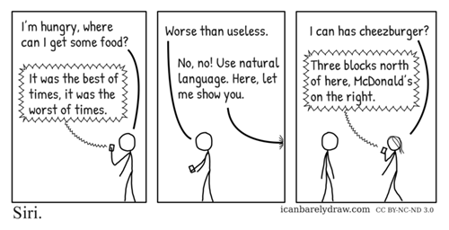
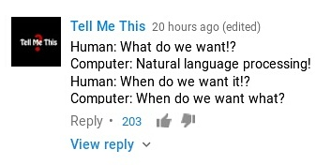
Questions?
Katherine.Sullivan@cuanschutz.edu Katherine.Sullivan@state.co.us

Slide 21
Twitter’s Academic Research Product Track:
https://developer.twitter.com/en/solutions/academic-research/application-info
https://developer.twitter.com/en/solutions/academic-research

